Slide 1
A/B Testing at Vungle Professor - Vatsal Maru MIS 6344.001 - Web Analytics

Slide 2



Team Members
Sri Priyadharshini Subramanian
Radhika Dubey
Sanjana Sasi

Slide 3
Vungle
In-app video advertising company
Optimizes ads for increased engagement and high-value user conversion.
Derives most of its revenue from ad conversions, specifically through app installs from these video ads – Cost Per Install
Considering using a new ad-serving algorithm driven by data science
Algorithm A: The current system in use.
Algorithm B: A new, data-driven algorithm.
Goal: Identify which algorithm delivers better conversion rates and higher eRPM

Slide 4
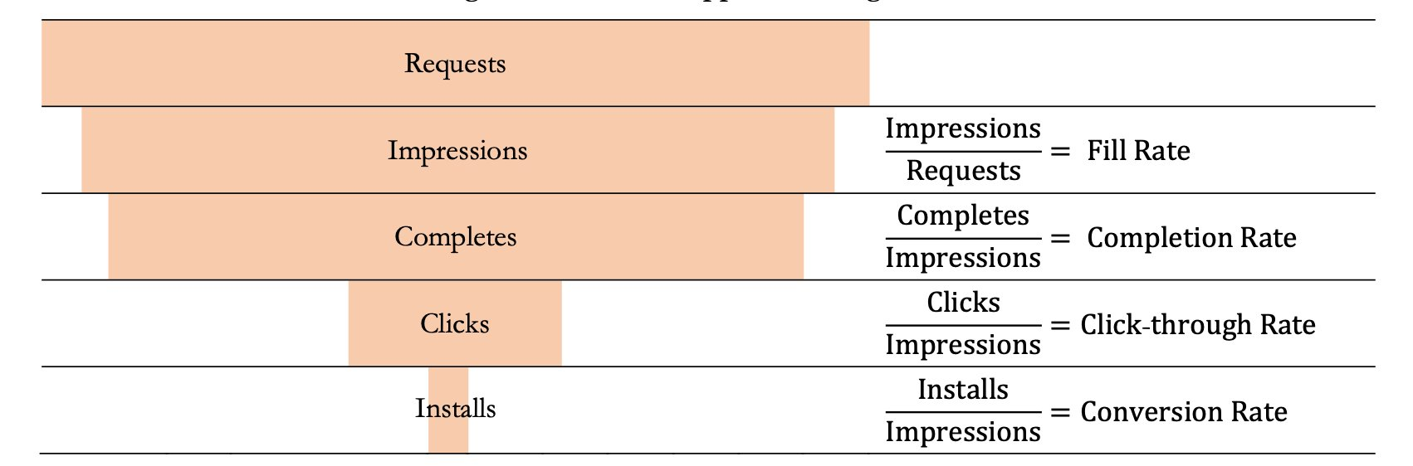
Initial Results
After two weeks of testing, Algorithm B showed promising results with daily eRPM averaging $0.131 higher than Algorithm A
Experiment conducted over a 30-day period, tracking metrics like impressions, completes, clicks, installs, and eRPM

Slide 5
Sampling
Used MD5 hashing for random user assignment, minimizing Sampling Bias.
​
Condition A (Existing Algorithm): 15/16 of users continue to be served ads using Vungle’s current ad-serving algorithm.​
Condition B (New Algorithm): 1/16 of users are randomly selected to receive ads served through the new, machine-learning-based algorithm.
The size of B is small to avoid big loss if the algorithm did not work well.

Slide 6
A/B Test Framework
Test Hypotheses:
H₀: No significant difference between Algorithm A and Algorithm B.
H₁: Algorithm B performs better than Algorithm A.
Metrics Considered:
eRPM - Effective revenue per 1000 impressions
Conversion Rate

Slide 7
T - test
H₀: µeRPM_{A} = µeRPM_{B}
H₁: µeRPM_{A} ≠ µeRPM_{B}
Significance Value (α) = 0.05
p-value = 0.13738211
p-value > α
We fail to reject Null hypothesis!

Slide 8
T – test - Interpretation
Interpretation: Since the p-value is greater than the typical significance level (0.05), we fail to reject the null hypothesis.
This suggests no significant difference in eRPM between Algorithm A and Algorithm B based on this test.
Is this test conclusive enough for the metric?
Considers samples to be independent of each other
Does not consider the day-to-day fluctuations that impact both algorithms in the same way.

Slide 9
Paired T-test
Significance Value α = 0.05
p-value = 0.002405648
p-value < α
We reject the Null hypothesis!
H₀: µeRPM_{B} - µeRPM_{A} = 0
H₁: µeRPM_{B} - µeRPM_{A} ≠ 0

Slide 10
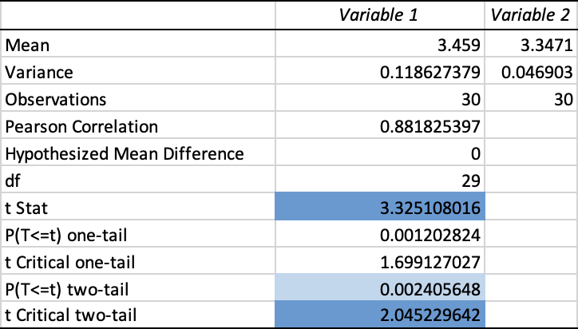

Slide 11
Paired T – test - Interpretation
Interpretation: p-value < 0.05
t Stat (3.33) > critical value (2.05)
This leads to the conclusion that the difference between the groups is statistically significant and suggests that Algorithm B significantly outperforms Algorithm A when considering paired observations.
Is this test conclusive enough for the metric? Since you have daily aggregates, you can directly calculate the difference in eRPM for each day. This will help eliminate the variation caused by daily fluctuations.

Slide 12
eRPM Conclusion
T-test result is less conclusive and we should consider Paired T-test instead as the standard error (SE) is lower as the difference in eRPM per day varies less.
Paired T-test points to the fact that for eRPM,
Algorithm B significantly outperforms Algorithm A

Slide 13
Z - test
Let's pick a different metric to test if the variability is significant!
Metric Chosen: Conversion rate – Proportion of installs over impressions
H₀: Conversion rate_{B} = Conversion rate_{A}
H₁: Conversion rate_{B} ≠ Conversion rate_{A}
Total Impressions A | 236,459,402
Total Impressions B | 15,825,376
Conversion Rate A | 0.004024649%
Conversion Rate B | 0.003540579%

Slide 14
Pooled Conversion Rate | 0.003994
Z Score | -29.55744395
Standard Error | 0.00001637
Pvalue for the z-score is extremely small (5.27×10⁻¹⁹², almost zero). Indicating that the observed difference in conversion rates is highly statistically significant, leading to strong evidence to reject the null hypothesis.
Algorithm A is doing better, considering the Conversion rate metric.

Slide 15
Conclusion
Algorithm B can increase revenue while reducing conversion rates.
Algorithm B more likely prioritized ads that had lower conversion chances and advertisers willing to pay a higher price for each successful install.

Slide 16
Implications
Vungle maximizes short-term revenues
Degrade in User Experience due to lower conversion rate
Imbalance in Ad diversity due to favoring high eRPM-generating Ads
Long term decline in impression and revenue
Recommendations:
Extend A/B testing
Experiment with Ad mix

Slide 17

Thank you!

